Slide 1


DS 2003: Communicating with Data
Class 13: Simple Linear Regression
Fall 2022

Slide 2


Linear Regression
Simply put, linear regression is a statistical model that analayzes the relationship between a response variable (e.g. y) and one or more explanatory variables
The most important feature of linear regression is that is assumes a linear relation
While not as sophisticated as other algorithms you will learn, linear regression is one of the most widely used algorithms by data scientists

Slide 3
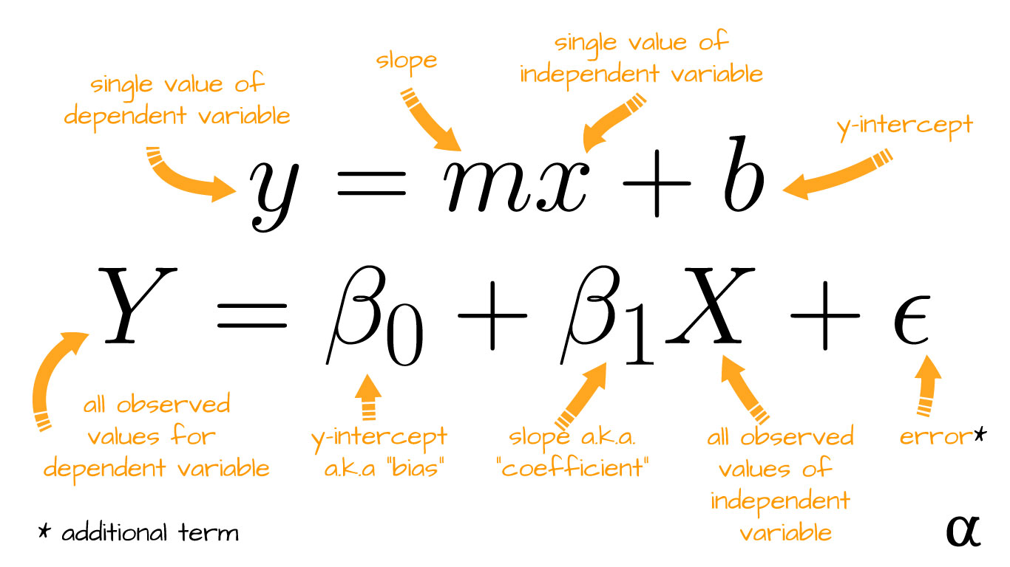
Regression Formula

Slide 4
Simple Linear Regression in R
Simple linear regression only uses one explanatory (independent) variable

Slide 5

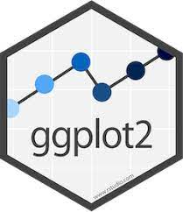
ggplot2 package
Created by Hadley Wickham in 1995 as an implementation of Wilkinson’s ‘The Grammar of Graphics’
One of the most popular R packages
Key components:
- Layer grammatical elements
- Aesthetic mappings

Slide 6
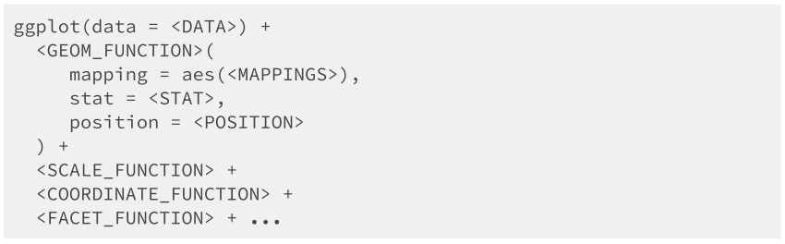
ggplot2 package

Slide 7
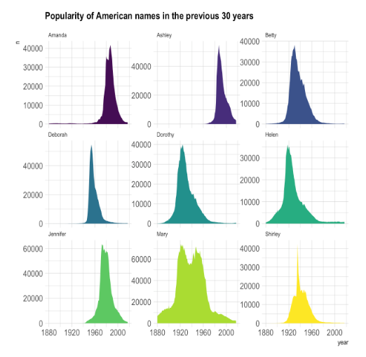
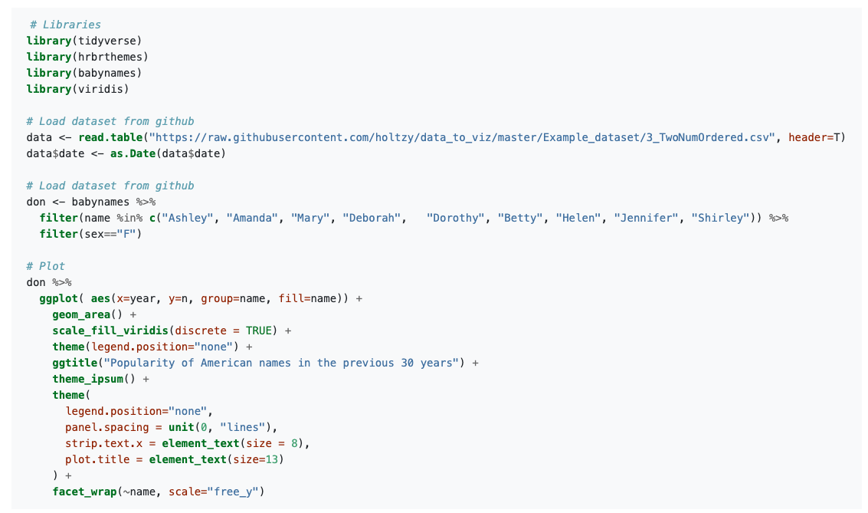
ggplot2 package

Slide 8
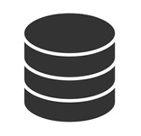


Data
Pretty self- explanatory
You need some type of data to create a plot
Could be as simple as a vector, but most likely going to be data frame imported from a csv

Slide 9
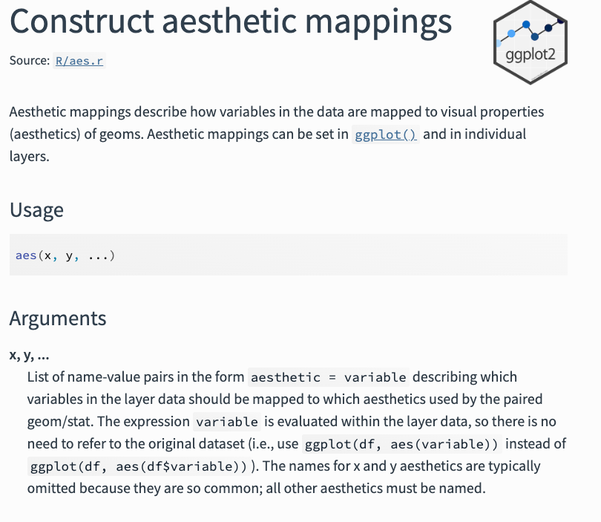
Mapping
Mapping allows datasets to be understood by the graphic system
Aesthetic mapping: link variables in data to graphical properties in the geometry
From ggplot2.tidyverse.org

Slide 10
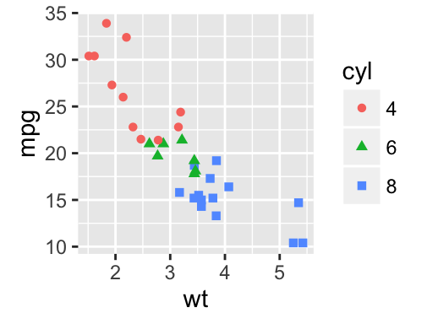
Mapping
Examples:
mpg is mapped to the y aesthetic
wt is mapped to the x aesthetic
cyl is mapped to the color aesthetic
Mapping to aesthetics helps us maximizes the amount of information we can display on a multivariate graph
Use aes()

Slide 11
Mapping
Can be called in the ggplot() function or in the geom layer
Usually call aes()in geom layer if you don’t want all layers to inherit the same aesthetics or are mixing datasets
In general, try to keep your data and aesthetics layer in the same ggplot function definition

Slide 12
Mapping : Typical Visible Aesthetics
AESTHETIC | DESCRIPTION
x | x axis position
y | y axis position
fill | fill color
color | color of points, outlines of other geoms
size | area or radius of points; thickness of lines
alpha | transparency
linetype | line dash pattern
labels | text on a plot or axes
*can be used in mapping and attributes

Slide 13
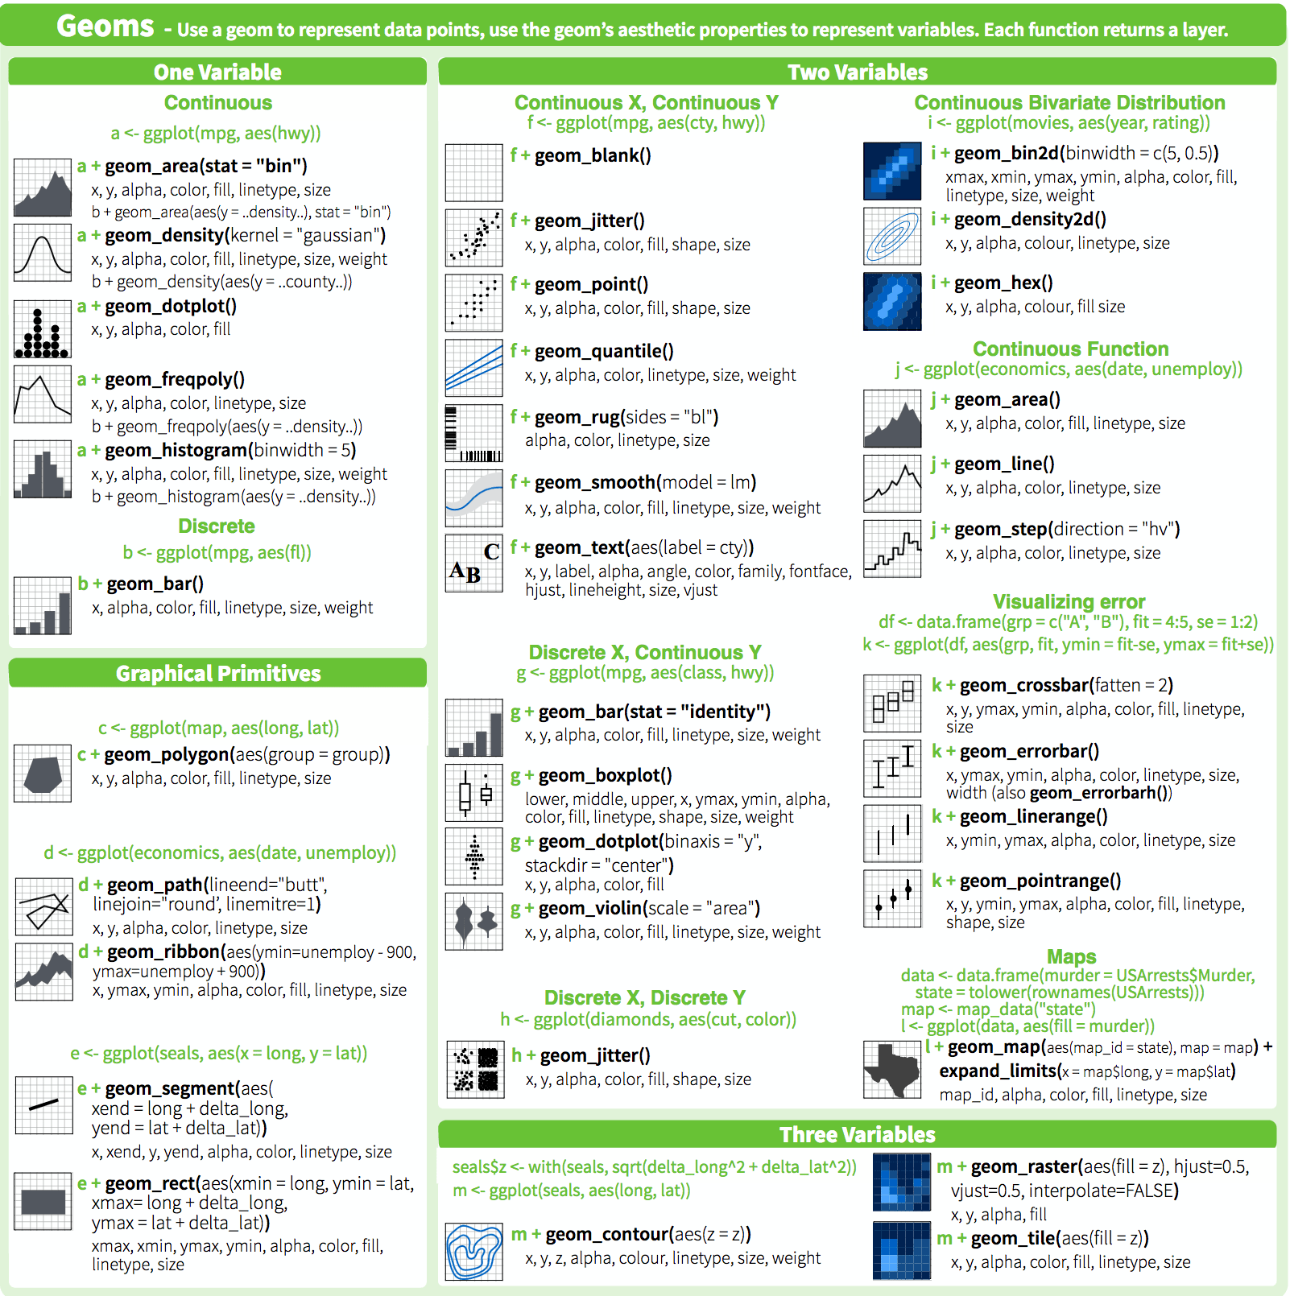
Geometries
There are 44 different geometries
https://ggplot2.tidyverse.org/reference/

Slide 14
Geometries
There are 44 different geometries
https://ggplot2.tidyverse.org/reference/

Slide 15
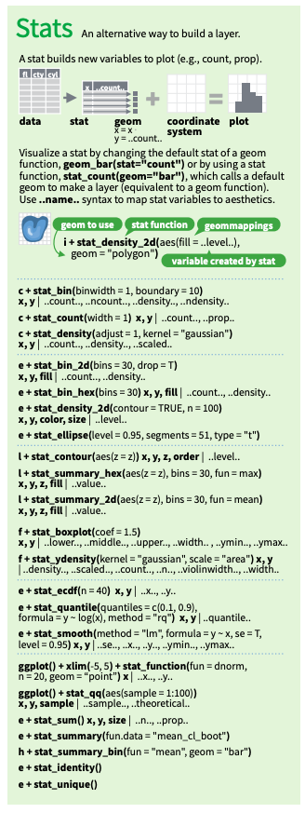
Statistics
Statistics transform input variables to displayed values. For example:
Count numbers of observations in each category for a bar chart
Calculate summary statistics for a boxplot
Essential statistics for plotting are computed by default.

Slide 16
Scales
Scales imply a specific interpretation of values (discrete, continuous, etc.)
Everything inside aes()will have a scale - if none is provided it will get a default
Scales follow a predictable naming scheme: scale_<aesthetic>_<type>
<type> can either be generic (e.g., continuous, discrete, or binned) or specific (e.g., log transformation, area)

Slide 17
Scales: Examples
Scales imply a specific interpretation of values (discrete, continuous, etc.)
Everything inside aes()will have a scale - if none is provided it will get a default
Scales follow a predictable naming scheme: scale_<aesthetic>_<type>
<type> can either be generic (e.g., continuous, discrete, or binned) or specific (e.g., log transformation, area)

Slide 18
Facets
Facets split data into multiple panels (i.e., small multiples)
Facets should not be used to combine multiple separate plots
ggplot2 provides two facets for splitting data by categories: facet_wrap() & facet_grid()

Slide 19
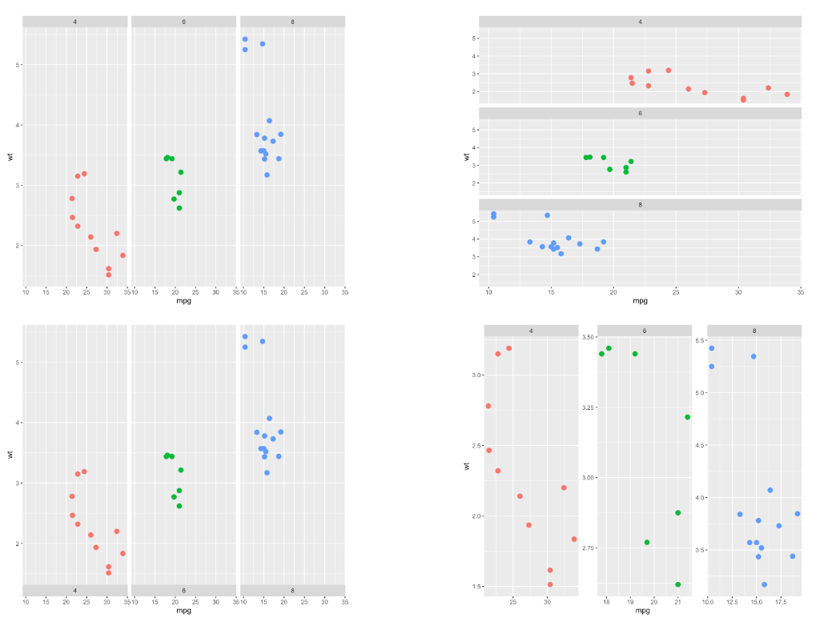
Faceting with facet_wrap()
facet_wrap() is the most common function for faceting with ggplot2
It builds a new chart for each level of a categorical variable
You can add the charts horizontally (graph1) or vertically (graph2, using dir="v")
Note that if the number of group is big enough, ggplot2 will automatically display charts on several rows/columns.

Slide 20
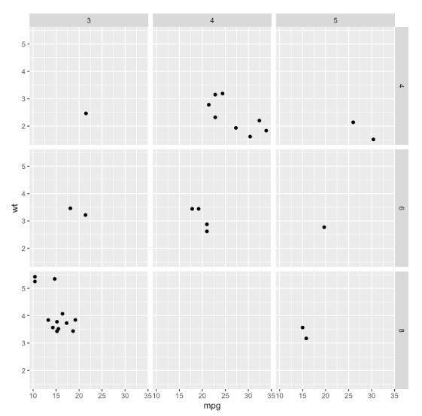
Faceting with facet_grid()
facet_grid()is the second function allowing to build small multiples with ggplot2
It builds one chart for each combinations of 2 categorical variables. One variable will be used for rows, the other for columns
The two variables must be given around a ~, the first being displayed as row, the second as column
The facet-grid() function also accepts the scales argument

Slide 21
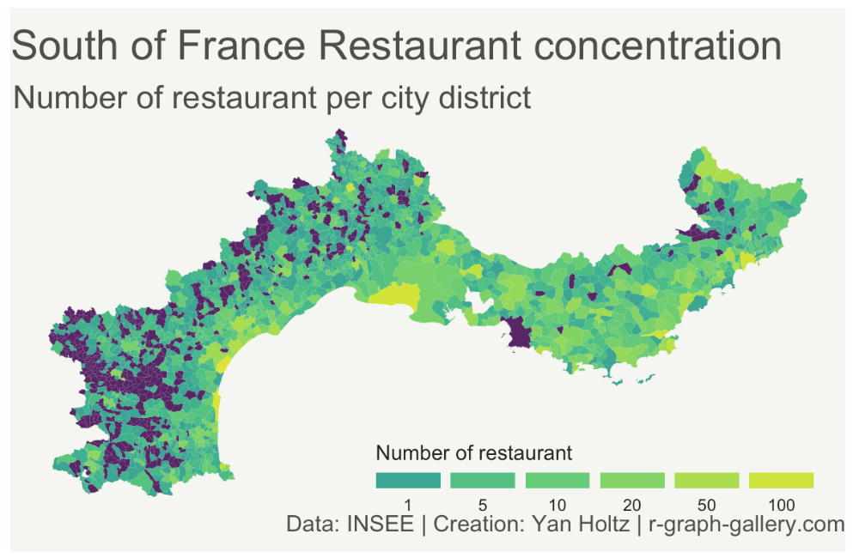
Coordinates
How should or be interpreted?
Limits and transformation can be applied in scale or in coord
Extremely useful in cartography (map projections)

Slide 22
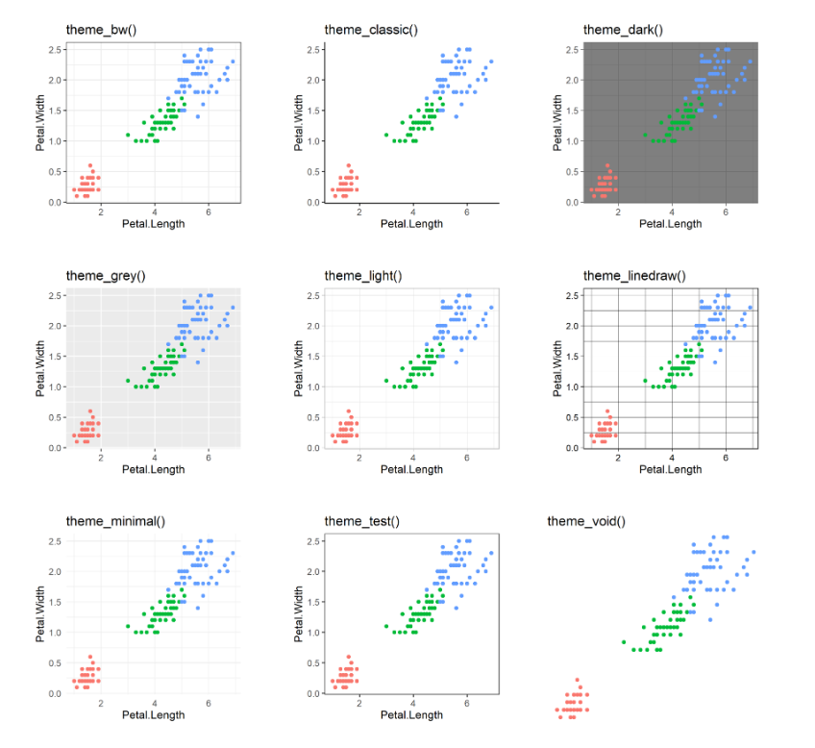
Themes
Stylistic changes to the plot not related to data
Themes can both apply complete themes or modify elements directly

